Slide 1




Slide 2



What is Major Medical Insurance?
Major medical insurance is a protection against an unexpected accident or illness, as it covers your medical and hospital expenses.

Slide 3
What is the insured sum?
It is the maximum amount that the insurer will pay for each claim (illness or accident) that occurs to you.
What is the deductible?
It is the insured's share of the cost of a claim.
It is important that you know that the insurer will not pay for accidents or illnesses whose care or treatment implies an amount less than the deductible.
What is coinsurance?
It is a percentage that is applied after the deductible to the total amount of expenses covered in a claim and this is covered by the insured.

Slide 4


Slide 5
Comparasion of Major Medical Insurance

Slide 6




RED MEDICA -VALLARTA
3 y 6 con: Banamex, Banorte, HSBC y Amex |  |  | 12 MESES: todas, excepto Banamex |  | 12 MESES: todas |  |  | 9 MESES: Banamex y 12 MESES: HSBC, Santander, Banorte, Bancomer y Amex
MONTHS WITHOUT INTEREST
RED MEDICA

Slide 7
What is the waiting period?
It is a period of time established in the policy (starting from the contracting of the insurance), during which the insurer does not cover the expenses for the medical care or treatment of certain diseases or conditions.
What is a preexistence?
It is the disease or illness that began before contracting the medical expenses insurance, which consequently are not covered by the insurance.

Slide 8
IT COVERS YOU FROM DAY 1:
Any accident
Food poisoning
Diarrhea or Gastroenteritis of infectious origin
Heat stroke (sunstroke)
Traumatic stroke
Acute myocardial infarction without coronary artery disease
Pulmonary thrombosis of traumatic origin
COVID-19 (Mapfre has a 30-day waiting period)

Slide 9
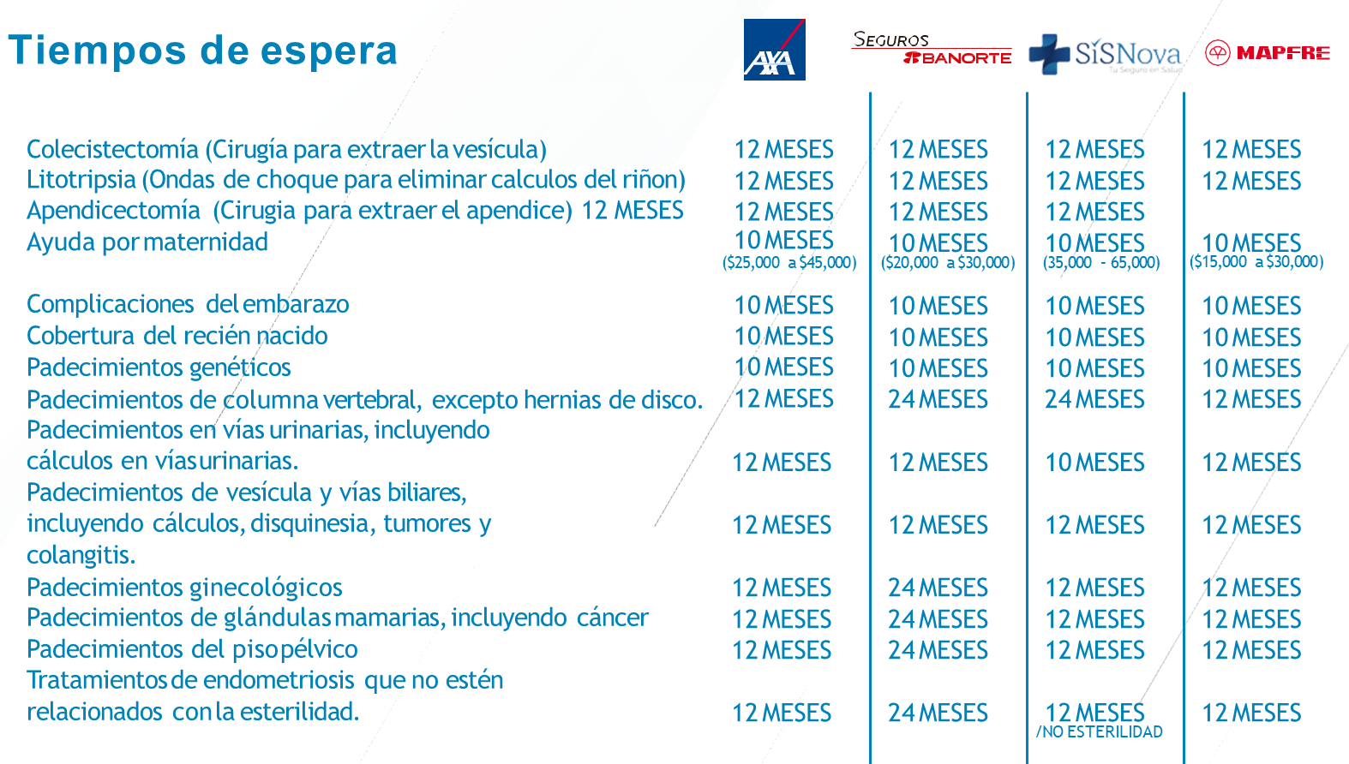

Slide 10


Slide 11

CONTACT:
Jeff Brown +52 322 141 4398 Jbrown5677mx@gmail.com

